Slide 1
New Product Launch
June 2020

Slide 2
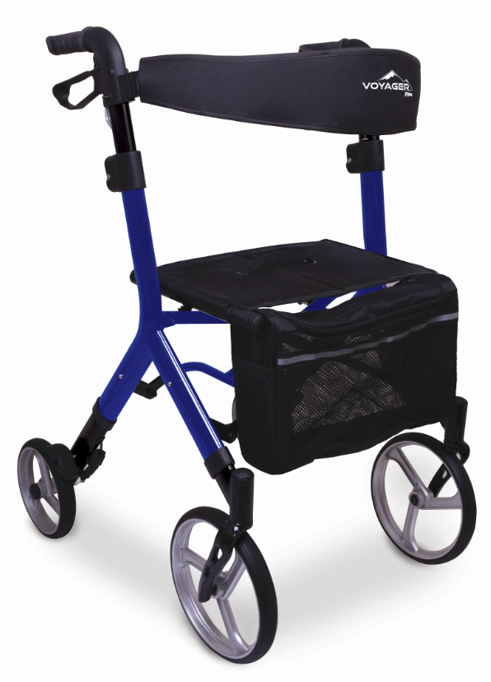
Voyager Euro-Style Rollator - Introduction
Introducing the new Voyager Euro-Style Rollator, a unique US/European hybrid design, with separate seat and handle height ranges that accommodate a wide range of user heights, from 4’11” – 6’4”.
The Voyager truly has no rival – it is the ONLY Euro rollator in the market that can call itself a “One Size Fits Most”!
…and with no real need for multiple units on the retail floor to accommodate various height users, the Voyager allows the dealer to show more color options while utilizing less floor space.
The Voyagers unique features and market position provide a heightened patient value while maintaining an equal Dealer profit margin to more expensive Euro-Rollators (like the Drive Nitro).

Slide 3
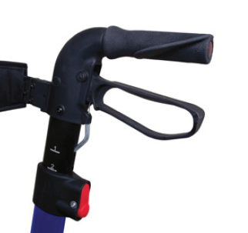
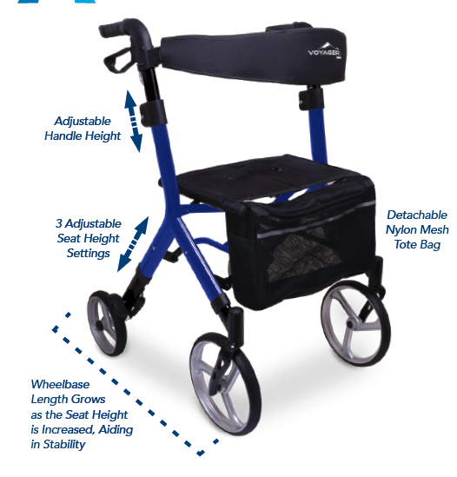
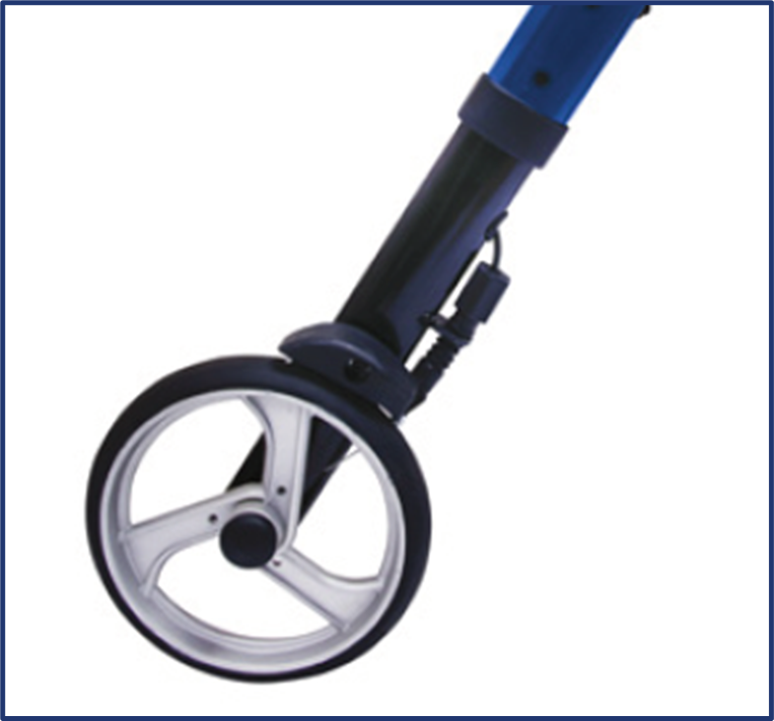
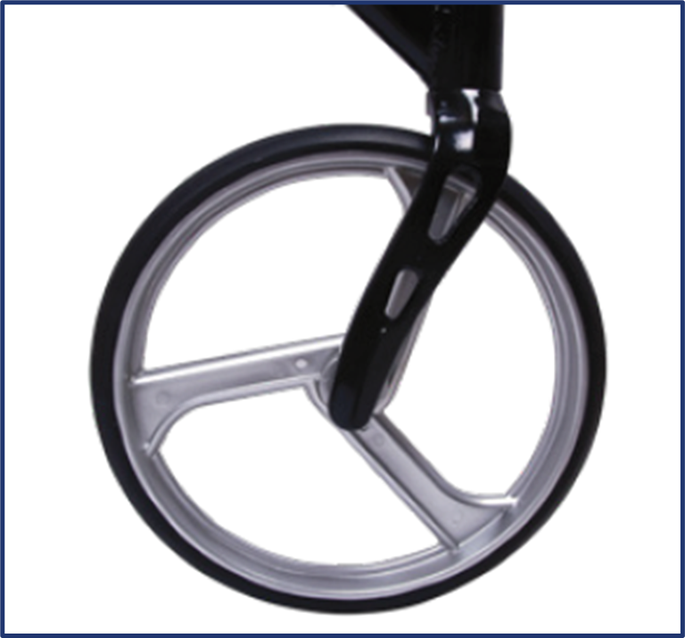
Voyager Euro-Style Rollator – Differentiation Slide
ADJUSTABLE SEAT HEIGHT - 3 settings take seat to floor height from 21” to 22” to 24”
EXPANDING WHEELBASE- maintains stability as the Seat Height is adjusted upward
EASY PUSH BUTON ADJUSTABLE HANDLE HEIGHT- Large red push buttons placed well below brake handles make handle height adjustment (1” increments) safe and easy
PROTECTED TOP TO BOTTOM BRAKING MECHANISM –
4a. Shielded brake cable
conduits beneath the handles
protects the cable at one of the
most frequent breakage points
4b. Cables are protected within
the frame to eliminate snags and
cable breakage as well as to
provide a clean, modern look
4c. Shielded brakes at the rear
wheels protect the mechanism
while offering a sophisticated
looking design
4d. Adjustment knob on the rear
braking mechanism allows for
easy brake tension maintenance
10-INCH FRONT CASTERS - reduce resistance for smooth
navigation
ATTRACTIVE NYLON MESH TOTE
is attractive and detachable
④a
④b
③
③
⑥
④c
④b
①
④d
②
⑤

Slide 4
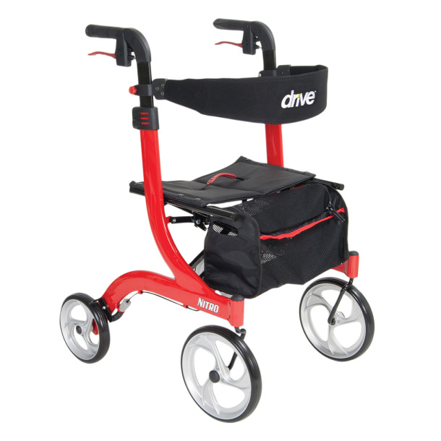
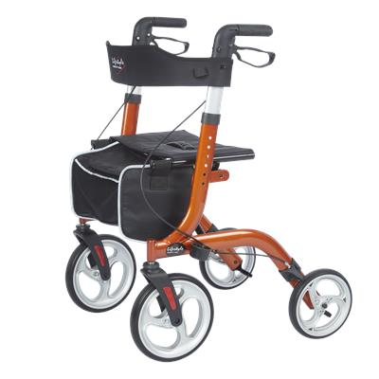
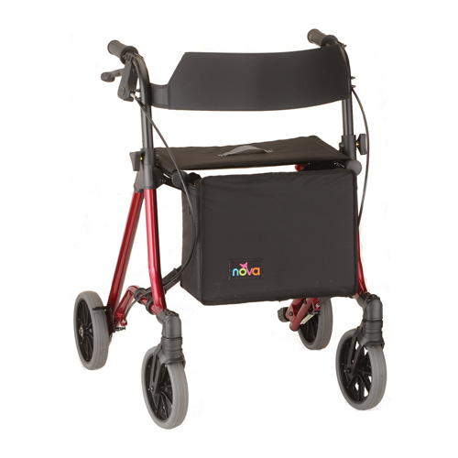
Voyager Euro-Style Rollator – Competitor Comparison
Specification | ProBasics Voyager | Drive Nitro | Lifestyles Venture | Nova Forté
Overall Width | 23.5” | 23” | 24.5” | 23”
Width between Handles | 20.25” | N/A | 18.25” | 16.25”
Seat Dimensions | 18” x 10” | 18” x 10” | 18.75”x 10.5” | 15” x 9”
Seat to Floor Height | 21” - 24” | 20.5” | 21.5” | 20.5”
Adjustable Handle Height | 35”- 42.5” | 33.5”- 38.25” | 33”- 38” | 30” to 34”
Weight Capacity | 300 lbs | 300 lbs | 300 lbs | 300 lbs
Caster Size | 10” front 8” rear | 10” front 8” rear | 10” front 8” rear | 8” front and rear
Product Weight | 16.4 lbs | 17.5 lbs | 15 lbs | 15.65 lbs
Shipping Weight | 21 lbs | 21.5 lbs | 20 lbs | 20.65 lbs
Colors Available
Warranty | Limited lifetime frame | Limited lifetime frame | Limited lifetime frame | Limited lifetime frame

Slide 5



Voyager Euro-Style Rollator – Pitch Slide
Do you give your clients the option of a high-end Rollator models to pay for out of pocket for vs an economy rollator that is covered by Medicare/private insurance? If so, what’s your go-to model and do you offer the option of using an ABN Form to pay the difference?
What if I could offer you a feature rich Euro-style model that would accommodate nearly all user heights, from junior to tall, that would offer great value to your clients and fantastic margin for you?............Let me tell you about our all-new Voyager!
CONVERSATION STARTERS
ONLY Hybrid US/Euro Design available in the market today
Large Euro-style, padded seat with handle folds side-to-side (not front-to-rear)
Three Seat Height Adjustments and independent Handle Height Adjustment allow for custom Seat and Handle Height fitment to each user
Enclosed, protected braking system reduces cable snagging on obstacles and breakage
10” front casters and 8” rear casters enhance look and functionality
Attractive front mounted tote bag doubles as a shoulder/crossover bag
Elongated tubing for rigidity & Euro styling in three attractive hi-gloss finishes
FEATURE RICH
Accommodating a wide range of user heights, the Voyager lowers dealer operating costs by reducing Dealer SKU’s, inventory investment and Rollator floor space
With its richness in product features and a unique market price position, the Voyager provides the user unparalleled value while delivering outstanding dealer profit margin
Expert | Target | Floor | MAP & MSRP
$129 | $119 | $109 | $199 $249
VALUE

Slide 6
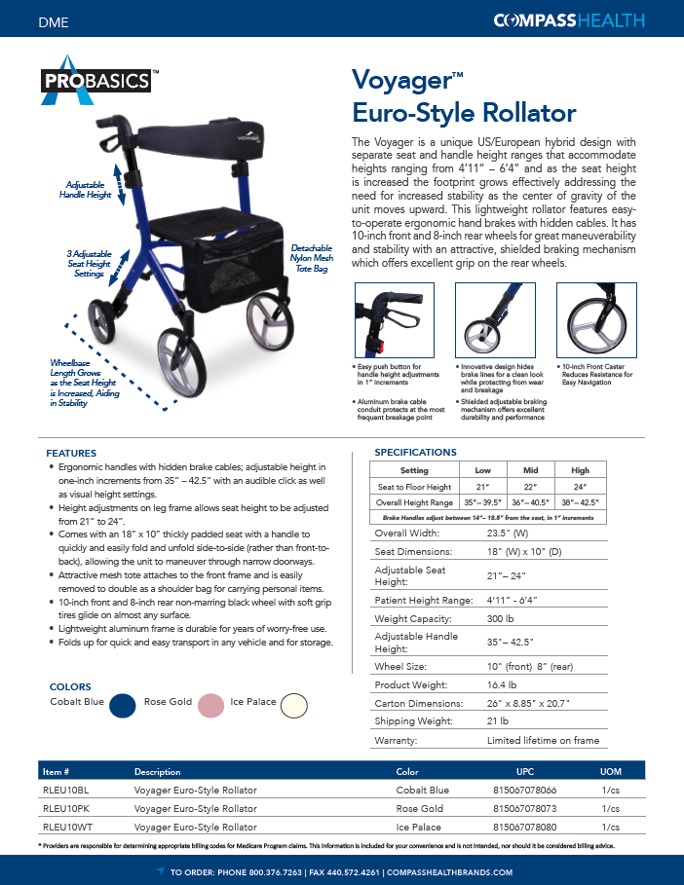

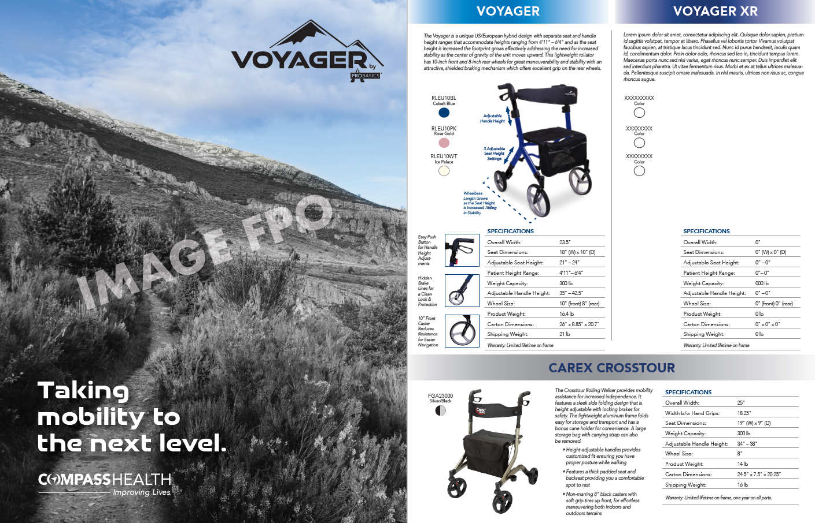
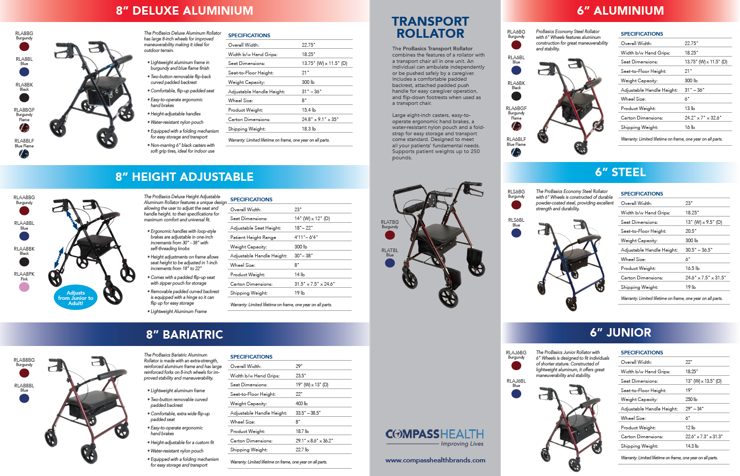
Voyager Euro-Style Rollator – Launch Materials
Voyager Launch Packet includes:
Voyager Euro-Style Rollator Sell Sheet
NEW Rollator Family Brochure
Training Deck
Voyager Hang Tag (User Manual)
Replacement Parts Schematic
Notable Dates:
6/23: Press Release and Pre-Sale Email Blast to Focus Customers
7/7: 2nd Email Blast to include Non-Focus Customers
7/27: Product arrival to OH (20) and GA (52)DC’s
8/3: Product arrival to CA (24) DC

Slide 7
Voyager Euro-Style Rollator – Final Recap
Until now, there has been a big gap in our Probasics Rollator line. The addition of the new Voyager not only fills that gap, but it offers a number of unique, differentiating features like we don’t offer in any product or family of products in our long list of product categories.
With its differentiating features, the Voyager not only fill s a gap in our Rollator line – it also fills a gap in the rollator market combining a Euro-Style design with an adjustable height seat that accommodates a wide range of users heights from 4’11” – 6’4”.
With independent Seat and Handle Height adjustability, the Voyager allows for a custom fitment to each user – a feature that is simply not offered by any other Euro-Style Rollator on the market. …And, as the seat height is increased, the wheelbase increases, effectively addressing the need for increased stability – also unique to the Voyager.
It that isn’t enough, the Voyager also boasts an innovative top-to-bottom protected braking mechanism that safeguards the entire system from breakage and offers easy tension adjustment.
The Voyager is constructed of durable and robust elongated tubing in three attractive, high-gloss, metallic finishes…Cobalt Blue, Rose Gold and Ice Crystal.
With the addition of the Voyager family (Voyager XR coming soon), Compass Health now has a complete line of rollators to suit the needs of any end-user, Medicare Dealer and HME Retailer.

