Slide 1
Mobility Product Training
Rollators
August 2019

Slide 2
Parts Logic – Rollators
RLA8BG

Slide 3
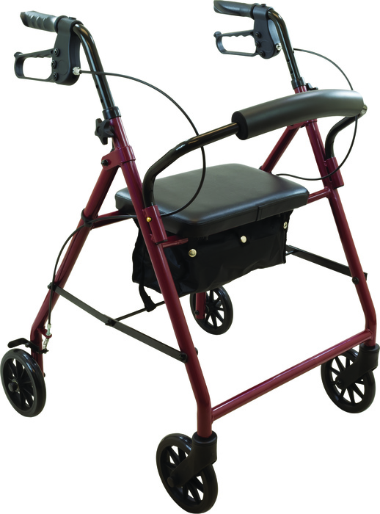
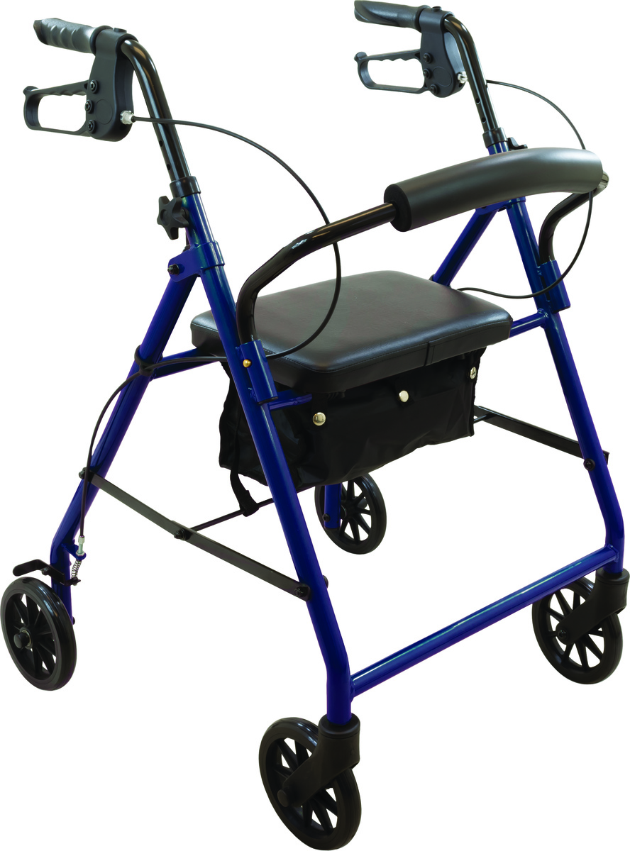
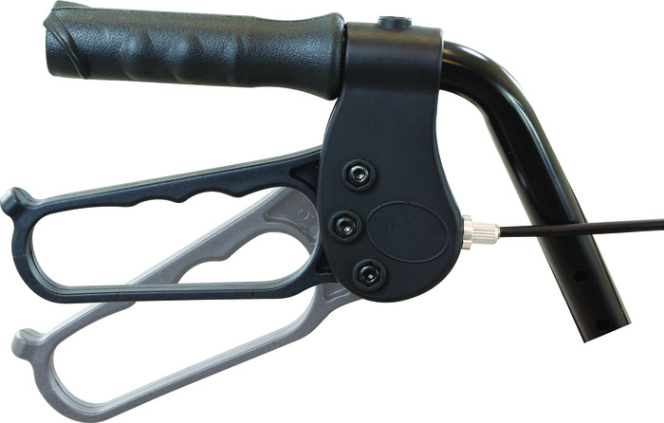
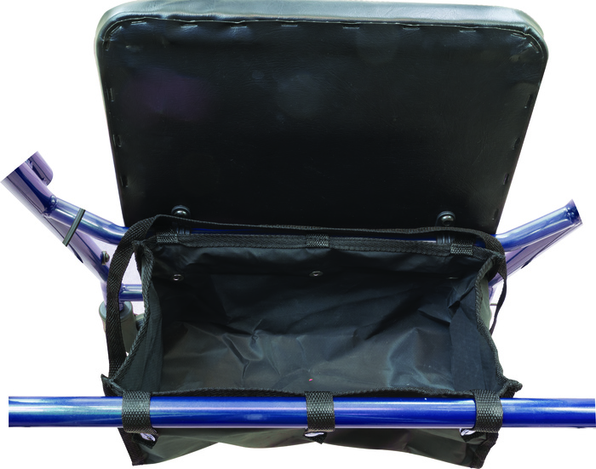
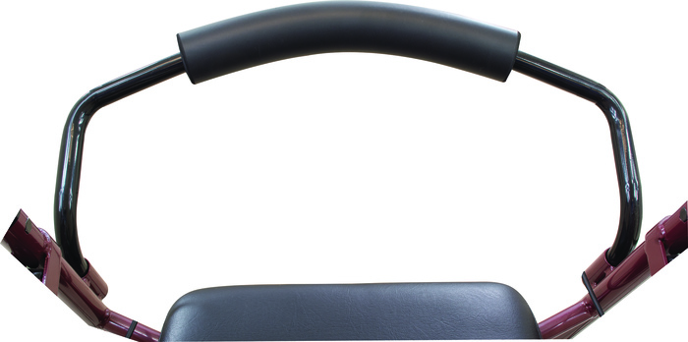
Economy Steel Rollators – 6” Wheels
Features and Benefits:
Durable powder-coated steel frame available in burgundy or blue
Removable, curved padded backrest
Comfortable, flip-up padded seat
Easy-to-operate ergonomic hand brakes
Height-adjustable for a custom fit
Water-resistant nylon pouch attaches under seat for added privacy and security of personal items
Equipped with an easy folding mechanism for storage and transport
Non-marring 6" black casters with soft grip tires,
ideal for both indoor and outdoor use
Limited Lifetime warranty on frame and 1 year on all parts
HCPCS Code: E0143, E0156 (seat)

Slide 4
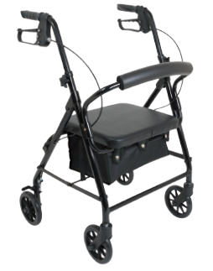
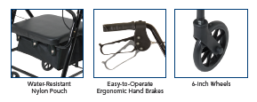
Aluminum Low Profile Rollator, 6” Wheels
Features and Benefits:
Lightweight aluminum frame available in black
Seat is 3" lower than a standard rollator to
accommodate individuals of shorter stature
Two-button removable padded backrest
Comfortable, Flip-up padded seat
Easy-to-operate ergonomic hand brakes
Height-adjustable for a custom fit
Water-resistant nylon pouch attaches under seat for added privacy and security of personal items
Equipped with an easy folding mechanism for storage and transport
Non-marring 6” black casters with soft grip tires, ideal for both indoor and outdoor use
Limited Lifetime warranty on frame and 1 year on all parts
HCPCS Code: E0143, E0156 (seat)
Discontinued

Slide 5
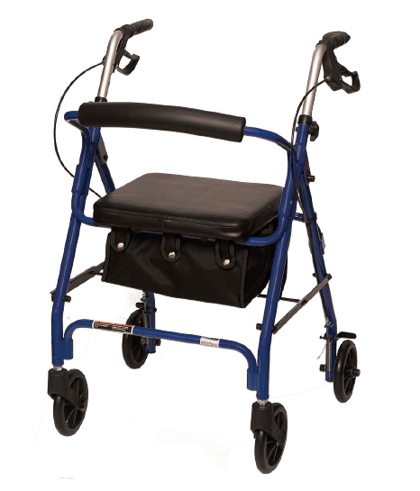
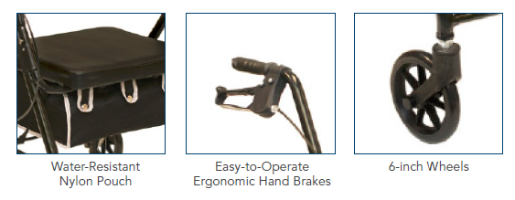

Aluminum Junior Rollator, 6” Wheels
Features and Benefits:
Lightweight aluminum frame available in burgundy and blue
Two-button removable padded backrest
Comfortable, Flip-up padded seat
Easy-to-operate ergonomic hand brakes
Height-adjustable for a custom fit
Water-resistant nylon pouch attaches under seat for added privacy and security of personal items
Equipped with an easy folding mechanism for storage and transport
Non-marring 6” black casters with soft grip tires, ideal for both indoor and outdoor use
Limited Lifetime warranty on frame and 1 year on all parts
HCPCS Code: E0143, E0156 (seat)

Slide 6
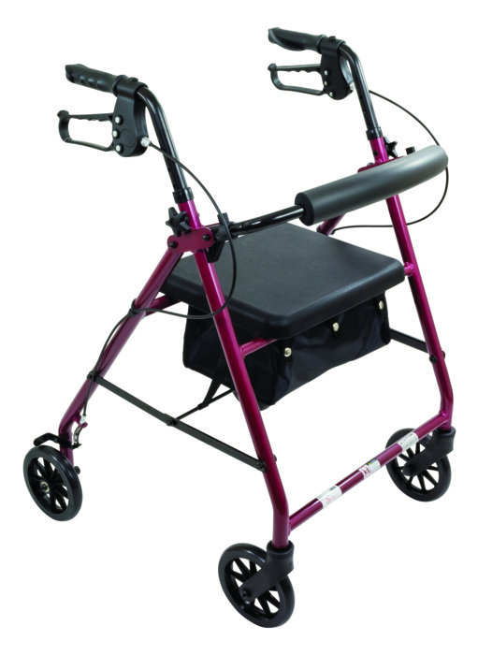
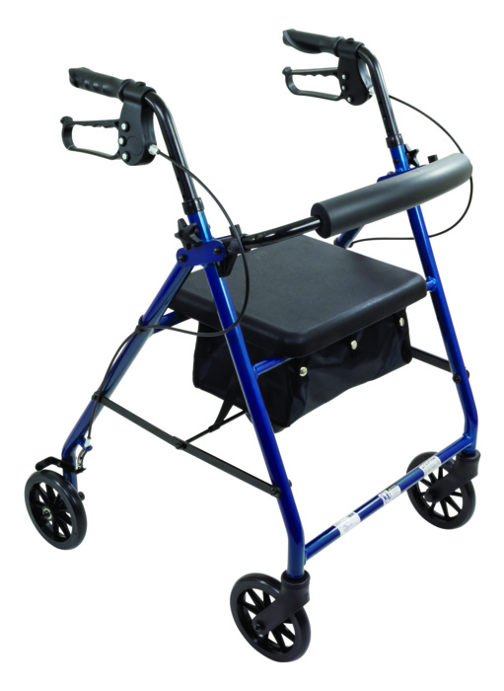
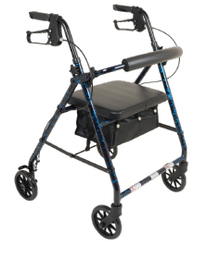
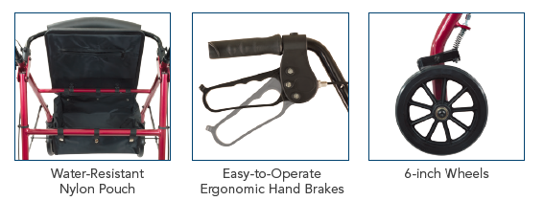


Aluminum Rollator, 6” Wheels
Features and Benefits:
Lightweight aluminum frame available in burgundy, blue and black
Two-button removable flip-up curved padded backrest
Comfortable, Flip-up padded seat
Easy-to-operate ergonomic hand brakes
Height-adjustable for a custom fit
Water-resistant nylon pouch attaches under seat for added privacy and security of personal items
Equipped with an easy folding mechanism for storage and transport
Non-marring 6” black casters with soft grip tires, ideal for both indoor and outdoor use
Limited Lifetime warranty on frame and 1 year on all parts
HCPCS Code: E0143, E0156 (seat)
Discontinued

Slide 7
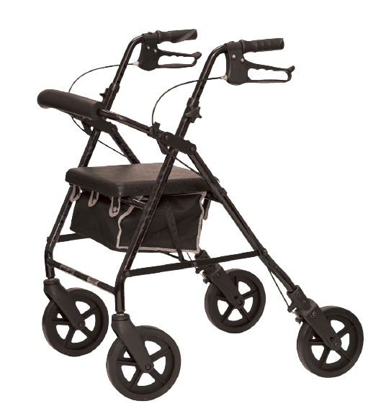
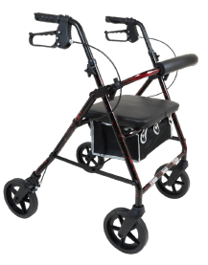
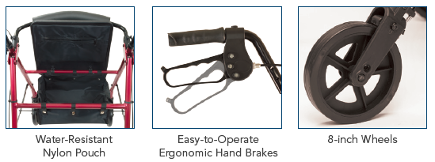

Deluxe Aluminum Rollator, 8” Wheels
Features and Benefits:
Sleek frame design has increased walking clearance while promoting better mobility
In-line brakes
8” heavy duty front and rear wheels with 5 ribs for increased stability.
Seamless, padded seat for improved comfort and ease of care.
Seat flips up and includes large, pouch underneath for secure storage.
Flip-up Padded backrest can be folded up or removed.
Durable, lightweight aluminum frame.
Easy squeeze locking loop brake system.
Handle height is easily adjustable.
Folds easily for storage and transportation.
Includes large pouch for additional storage
Limited Lifetime warranty on frame and 1 year on all parts
HCPCS Code: E0143, E0156 (seat)

Slide 8

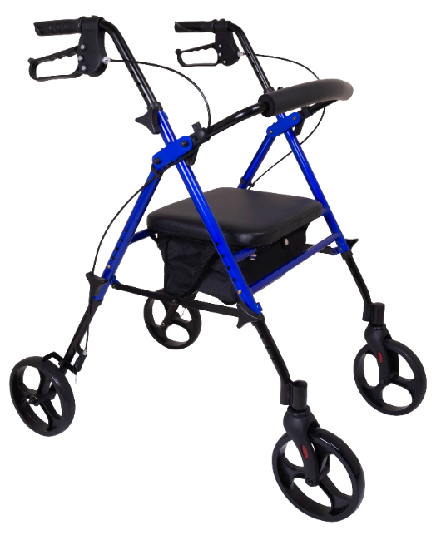



Deluxe Height Adjustable Rollator, 8” Wheels
Features and Benefits:
Ergonomic handles with loop-style brakes, adjustable in 1” increments from 30” – 38” with self threading knob.
Height adjustment on seat adjusts in 1” increments from 18” – 22”
Includes padded flip-up seat with Zipper pouch for storage.
Convenient storage pouch attaches to frame underneath seat for extra protection.
Removeable padded curved backrest quipped with hinge.
8” non-marring black wheels with soft grip tires for indoor and outdoor use.
Lightweight aluminum frame.
HCPCS Code: E0143, E0156 (seat)
Presale in August, Sept Delivery

Slide 9
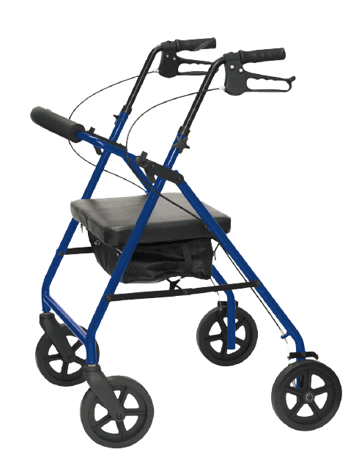
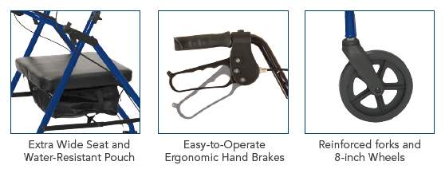
Aluminum Bariatric Rollator, 8” Wheels
Features and Benefits:
Lightweight aluminum frame
Two-button removable Flip-up curved padded backrest
Comfortable, extra wide flip-up padded seat
Easy-to-operate ergonomic hand brakes
Height-adjustable for a custom fit
Water-resistant nylon pouch attaches under seat for added privacy and security of personal items
Equipped with a folding mechanism for easy storage and transport
Non-marring 8" black casters with reinforced forks and soft grip tires, ideal for both indoor and outdoor use
Limited Lifetime warranty on frame and 1 year on all parts
HCPCS* Code: E0149/E0156 (seat)

Slide 10
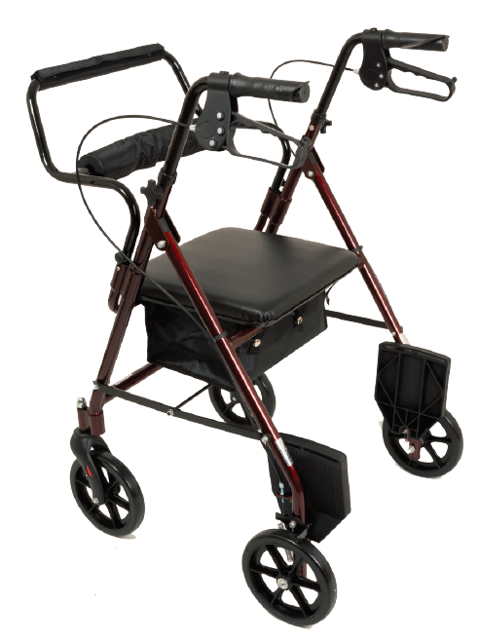
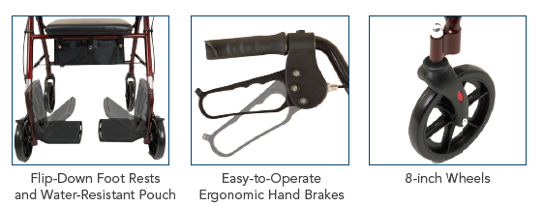
Aluminum Transport Rollator, 8” Wheels
Features and Benefits:
Lightweight aluminum frame with burgundy or blue finish
Fold-down footrests and padded backrest for easy conversion from rollator to transport mode
Comfortable, flip-up padded seat
Easy-to-operate ergonomic hand brakes
Height-adjustable for a custom fit
Water-resistant nylon pouch attaches under seat for added privacy and security of personal items
Equipped with a folding mechanism for easy storage and transport
Non-marring 8" black casters with soft grip tires, ideal for both indoor and outdoor use
Limited Lifetime warranty on frame and 1 year on all parts
HCPCS* Code: E0143/E0156 (seat)

