Slide 1
Respiratory Training

Slide 2
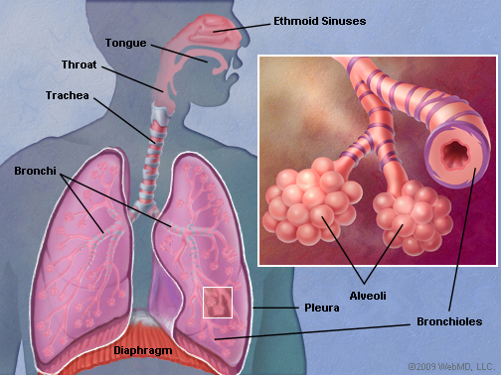
Lungs
Lungs – a pair of organs in the chest that supplies the body with oxygen, and removes carbon dioxide from the body.
The trachea (windpipe) conducts inhaled air into the lungs through its tubular branches, called bronchi. The bronchi then divide into smaller and smaller branches (bronchioles), finally becoming microscopic.
The bronchioles eventually end in clusters of microscopic air sacs called alveoli. In the alveoli, oxygen from the air is absorbed into the blood. Carbon dioxide (a waste product), travels from the blood to the alveoli, where it can be exhaled.
The lungs are covered by a thin tissue layer called pleura, a thin layer of fluid acts as a lubricant allowing the lungs to slip smoothly as they expand and contract with each breath.

Slide 3
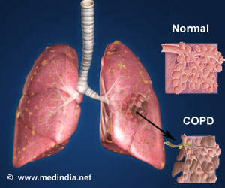
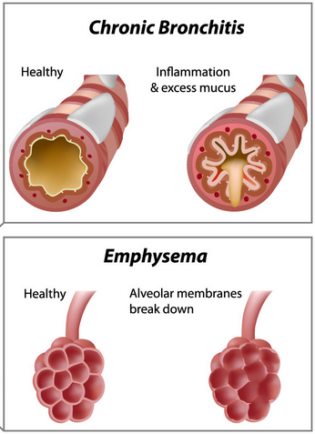
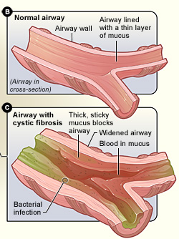
Lung Conditions
Chronic Obstructive Pulmonary Disease (COPD) – Chronic inflammatory lung disease that causes obstructed airflow from the lungs. The most common cause is smoking.
Symptoms include:
Difficulty breathing
Coughing
Mucus production
Wheezing
Emphysema – A form of COPD, the fragile walls between the lungs’ air sacs (alveoli) are damaged, trapping air in the lungs and making breathing difficult.
Chronic Bronchitis – A form of COPD, inflamed bronchial tubes produce a lot of mucus leading to coughing and difficulty breathing.
Cystic Fibrosis – A genetic disorder that causes severe damage to the lungs, digestive system and other organs. Cystic Fibrosis affects the cells that produce mucus, sweat and digestive juices. These fluids that are normally thin and slippery, acting as a lubricant, become thick and sticky in patients with Cystic Fibrosis.

Slide 4
Oxygen Therapy Overview
The earth’s air is made up of approximately 21% oxygen with the remainder being nitrogen and few trace elements. Our body cells must have energy to function and these cells get their energy from a combination of the food we eat and the oxygen that we breathe.
It is like the process of burning fuel, food is the fuel but it will only burn and produce energy in the presence of oxygen. When the cells don’t get enough oxygen, hypoxia occurs.
Hypoxemia – (low O2 in blood) causes hypoxia (low O2 in tissue) when blood doesn’t carry enough oxygen throughout the body. The term hypoxia is sometimes used to describe both problems.
Causes of Hypoxia
Lung diseases – COPD (emphysema, bronchitis) is the 3rd leading cause of death in the U.S., 11 million people have been diagnosed and an estimated 24 million are undiagnosed
Heart problems – Heart disease is the leading cause of death in the U.S., 26.6 million people have been diagnosed
Severe asthma attack – 25 million people have been diagnosed with asthma
Anemia – low number of red blood cells, which carry oxygen
Patients may need to use supplemental oxygen continuously, at night, or just while walking and exercising.
When used medically, oxygen is a prescription drug and requires a physician’s order for use. It can be supplied in a more concentrated form as a gas stored in oxygen tanks, from the use of an oxygen concentrator, or from a liquid oxygen system.

Slide 5
Oxygen Cylinders
Oxygen cylinders, or tanks, store oxygen gas under great pressure. They are available in several sizes, but most common are M6, C, D, and E.
Roscoe Medical currently offers Cylinders from two Manufacturers:
Catalina Cylinders for private label – cylinders are aluminum and come standard with Young Do valves, made in Korea. Sherwood valves are available upon request.
Metal Impact, LLC – cylinders are aluminum
3 Types of Valves
The tanks contain oxygen in gas form and require a regulator or conserving device to operate.
Delivery of oxygen to the patient is most often through a cannula or oxygen mask.
Toggle
CGA-870
Wrench CGA-870
Spigot CGA-540

Slide 6
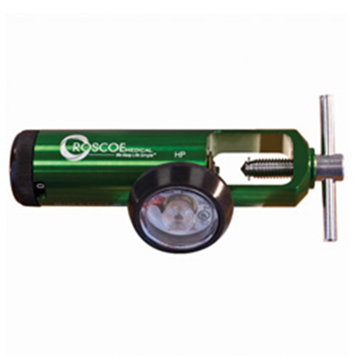
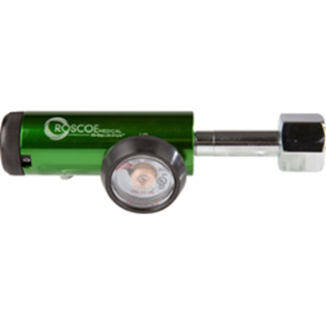
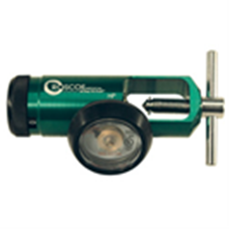
Oxygen Regulators
Oxygen Regulators – used to transfer oxygen stored at high pressure within a cylinder to a much lower pressure. Regulators have a “click-style” adjustment built in which allows the oxygen administrator to control the flow of oxygen to the patient in liters per minute (LPM), as needed.
Roscoe Medical’s regulators have an aluminum body and all brass core, which is standard in the industry.
Flow Ranges and Part Numbers:
0-4 LPM (Pediatric) – RMI-04ST
0-8 LPM (Adult) – RMI-08ST, RMI-08MINI, RMI-08H, RMI-08HB
0-15 LPM (Adult) – RMI-15ST, RMI-15MINI, RMI-15H,

Slide 7
Oxygen Conservers
Oxygen Conserving Devices – used much like a regulator, however, it has the ability to conserve the amount of oxygen gas used by delivering intermittent flows of oxygen during inhalation only, shutting off during the balance of the breathing cycle.
Since the oxygen is delivered continuously, oxygen is conserved and the cylinder lasts significantly longer. Therefore, an oxygen patient can either choose to continue to use a larger cylinder and have it last significantly longer (2-5 times), or use a much smaller cylinder allowing better mobility.
Single lumen conservers use a single cannula where negative and positive pressure goes through a single tube.
Dual lumen conservers utilize a special cannula that senses on one side and delivers oxygen through the other tube; optimal for shallow breathers or those who require a more sensitive device to trigger the oxygen.
2 Types of OCD’s:
Pneumatic – powered by gas pressure
Roscoe Medical Single Lumen Conserver – ROS-50044
Roscoe Medical Dual Lumen Conserver – RMI-DLCON
Chad Bonsai Single Lumen Conserver – OM-812
Electronic – powered by batteries
Chad Evolution Single Lumen Conserver – OM-900

Slide 8
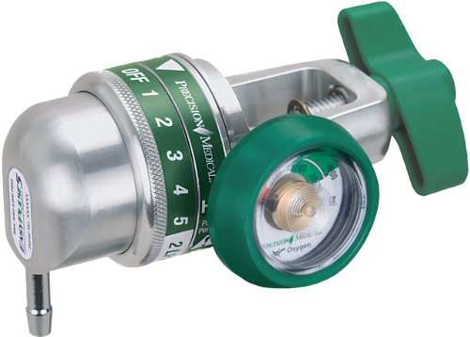
Precision Medical -EasyPulse 5 Conserving Device
Compact, Lightweight and Easy
The smallest and lightest oxygen conserver available weighing under 10 oz.
Single dial control and ergonomically designed T-Handle/Hand Tight nut make setting and connecting the EasyPulse 5 easy for any patient or caregiver
Helps Reduce Costs
With a conserving ratio of up to 5.7:1, the EasyPulse 5 reduces deliveries of cylinders. Its proven pneumatic reliability, robust design and lack of batteries help to reduce operating costs.
Dimensions: 4.8”L x 2.6”W x 2.5”H
Case Dimensions: 3”L x 5.5”W x 3.75”H
Weight: 9.86 oz. (0.28 kg) / 13.6 oz. (Shipping)
Inlet Pressure Range: 300-3000 psig
Internal Regulated Pressure: 50 psig
Operating Altitude Range: Sea Level to 10,000’
Pulse Settings: 1, 2, 3, 4 and 5
Flow Settings: 2 LPM Continuous
Savings Ratio: Up to 5.7:1
Cannula Requirements: Single Lumen w/ up to 7’ Tubing
Cylinder Connection: CGA-870
Warranty: 2 Years

Slide 9
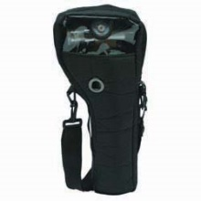
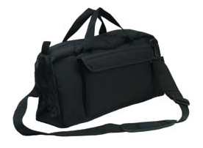
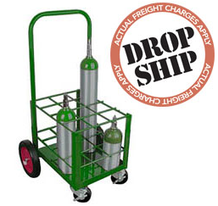
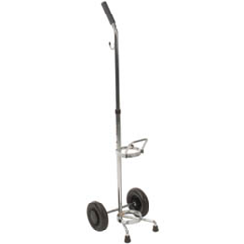
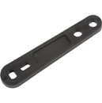
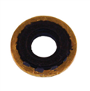
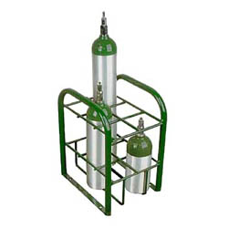
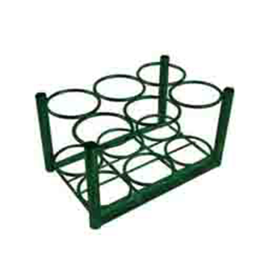
Oxygen Accessories
Cylinder Accessories
Compass Health Brands carries several accessories to be used with cylinders, some of which are:
Cylinder Bags – M6-BAG, C-BAG, and D-BAG
Cylinder Carts – manufactured by Anthony Welded
Cylinder Racks and Stands
Cylinder Wrenches
Yoke Washers
Post Valve Seals

Slide 10
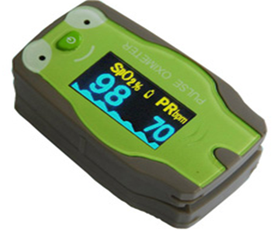
Pulse Oximetry
Overview of Pulse Oximetry
Pulse oximetry is a non-invasive method allowing the monitoring of the oxygenation of a patient’s hemoglobin. A sensor is placed on a thin part of the patient’s body, usually a fingertip or earlobe, and a light containing both red and infrared wavelengths is measured, allowing determination of the absorbance due to the pulsing arterial blood alone.
SpO2 – Pulse Oximeter Oxygen Saturation
Mild Hypoxia – SpO2 100-80% - Normal to lower, does not affect the functioning of the brain or the senses
Moderate Hypoxia – SpO2 80-60% - Does not cause a loss of consciousness or affect breathing, but does significantly affect the functioning of the brain and senses
Severe Hypoxia – SpO2 60-40% - Extension to the affects of moderate hypoxia to involve more aspects of the eye and brain function
Extreme Hypoxia – SpO2 < 40% - Eventually causes failure of brain stem functions

Slide 11
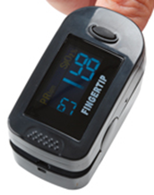
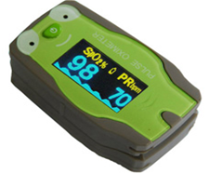
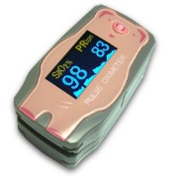
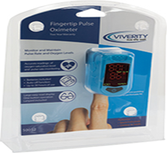
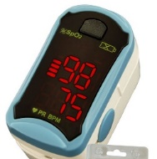
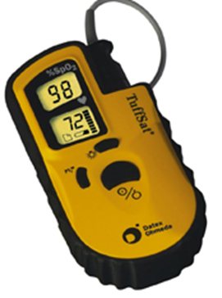
Pulse Oximeter Product Offering
Finger Pulse Oximeter 2-way color display
Prescription Only
Used by patients at home and caregivers to spot check
Ideal for emergency, hospital, or clinical environments
Pediatric Finger Pulse Oximeter with 6-way display vs. 2 color display
Prescription Only
Used by pediatric patients at home and caregivers to spot check
Ideal for emergency, hospital, or clinical environments
Finger Pulse Oximeter – Retail Packaging
OTC Approved
Used by patients at home
Ideal for home environment, patients without prescriptions
Datex-Ohmeda Tuffsat Pulse Oximeter – Handheld pulse oximeter
Ideal for professional settings: EMS, Hospitals, Transports
Various OxyTip® Sensors and Cables available

Slide 12
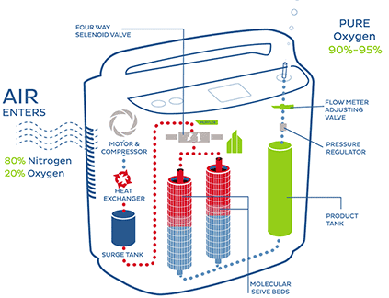
Oxygen Concentrator
Oxygen Concentrator – device which concentrates the oxygen from a gas supply (typically ambient air) to supply an oxygen enriched gas stream.
How does a concentrator work?
Takes air from its surroundings
Compressing air, while the cooling mechanism keeps the unit from overheating
Removing nitrogen from air via filter and sieve beds
Adjusting delivery setting with electronic interface
Delivering purified oxygen via nasal cannula or mask

Slide 13
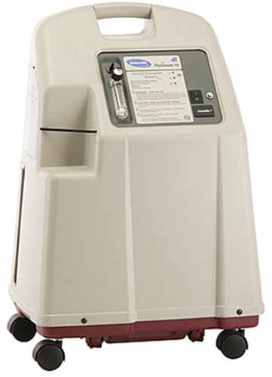
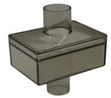
Concentrator Filters
Types of Concentrator Filters:
Cabinet Filters
Compressor Intake Filters
Final Bacteria Filters

Slide 14
Portable Oxygen Concentrators
Portable Oxygen Concentrator (POC) is a portable device used to provide oxygen therapy to people requiring greater oxygen concentrations than the levels of ambient air. It is similar to a home oxygen concentrator, but is smaller in size and more mobile. The portable oxygen concentrator makes it easy for patients to travel freely; they are small enough to fit in a car and many concentrators are now FAA-approved for use on airplanes.
One of the most important features of a POC is the oxygen purity it provides. The purity percentage is 88-95%.
EasyPulse Theory of Operation
The EasyPulse POC is a pulse delivery portable oxygen concentrator for highly ambulatory use by oxygen therapy patients. In order to maintain their quality of life, a highly ambulatory patient needs a product that is small, lightweight and easy to use.
With the CMV Technology, the patient will always know how long their battery will last.
The patient can continue to use the concentrator while it is charging.

Slide 15
Precision Medical - Controlled Minute Volume (CMV) Technology
Precision Medical’s
Controlled Minute Volume (CMV) Technology
The patented CMV technology is available only from Precision Medical, Inc.
CMV technology utilizes a pulse waveform algorithm, superior trigger sensitivity and fast delivery time.
CMV is the most efficient, reliable and clinically sound technology available today.
CMV is the only conserving technology that mimics continuous flow oxygen therapy, pneumatically or electronically.
This is achieved by delivering a consistent amount of oxygen per minute regardless of patient breath rate.
CMV delivers a true pulse of oxygen upon each breath within the first 1/3 of inhalation. The volume of the pulse automatically adjusts to the patient's breath rate, maintaining minute volume.
Benefits of CMV Technology for the provider and patient:
- Predictable use time - Excellent Patient Saturation
- Reduced operations costs - Easy to use
- Efficient oxygen delivery - Durable and reliable
- Single lumen cannula

Slide 16
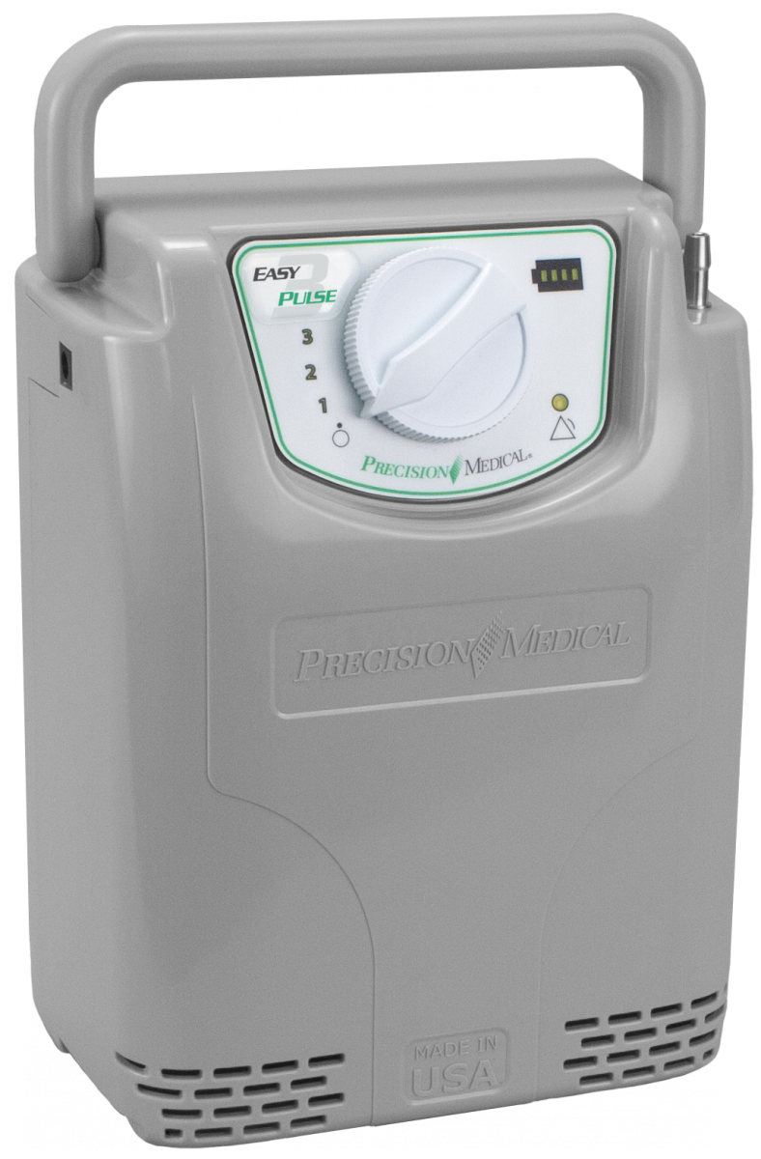
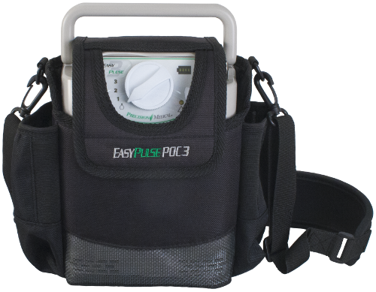
Precision Medical EasyPulse POC-3
Product Features and Specs
PM4130
Accessories: AC and DC Power Supplies, Cords, Carry Bag and High-Flow Cannula
Sound Level: 42dBA (at Setting 2)
Cannula: Maximum 7’ (2.1m) long – standard adult single lumen Nasal Cannula
Breath Rate Range: Up to 35 breaths per minute
Oxygen Concentration: 87%-95%
Oxygen Minute Volume (at sea level):
Setting 1: 240 ±15% ml/min
Setting 2: 380 ±15% ml/min
Setting 3: 520 ±15% ml/min
Approx. Battery Duration(s) at any breath rate:
Setting 1: 5.5 hours
Setting 2: 3.8 hours
Setting 3: 2.8 hours
*Easy to read battery level indicator
* Internal battery charge time: about 4 hours
Weight (lbs): 4.9 / 10.82 (shipping)
Dimensions (without bag): 4.5”L x 6.5”W x 8.5”H
Case Dimensions: 13.5”L x 15.5”W x 10.5”H
Power: AC - 100-240VAC (1.0 A @ 120 VAC)
DC - 11-16VDC (5.0 A @ 12VDC)
Warranty: 5 Years on Device, One Year on Battery
Case GTIN: 00855887006085

Slide 17
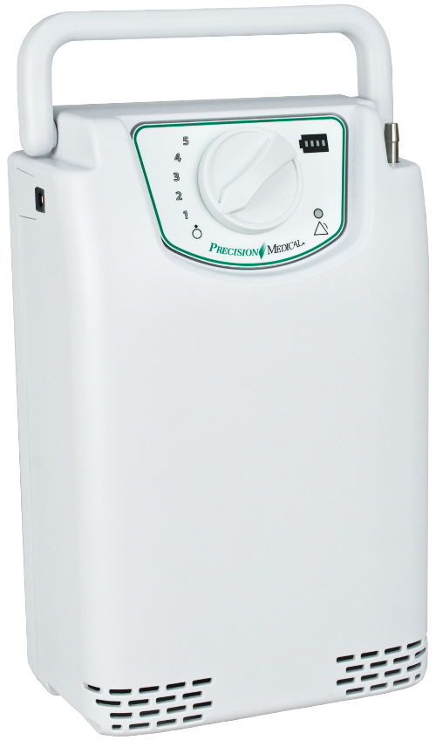
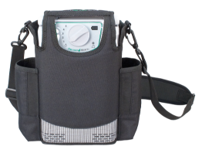
Precision Medical EasyPulse POC
Product Features and Specs
PM4150
Accessories: AC and DC Power Supplies, Cords, Carry Bag and High-Flow Cannula
Sound Level: 44dBA (at Setting 2)
Cannula: Maximum 7’ (2.1m) long – standard adult single lumen Nasal Cannula
Breath Rate Range: Up to 35 breaths per minute
Oxygen Concentration: 87%-95%
Oxygen Minute Volume (at sea level):
Setting 1: 240 ±15% ml/min
Setting 2: 380 ±15% ml/min
Setting 3: 520 ±15% ml/min
Setting 4: 660 ±15% ml/min
Setting 5: 780 ±15% ml/min
Approx. Battery Duration(s) at any breath rate:
Setting 1: 5.5 hours
Setting 2: 3.8 hours
Setting 3: 2.8 hours
Setting 4: 2.0 hours
Setting 5: 1.6 hours
*Easy to read battery level indicator
* Internal battery charge time: about 4 hours
Weight (lbs): 6.6 / 12.15 (Shipping)
Dimensions: 4.5”L x 6.5”W x 10.1”H
Case Dimensions: 13.5”L x 15.5”W x 10.5”H
Power: AC - 100-240VAC (1.0 A @ 120 VAC)
DC - 11-16VDC (5.0 A @ 12VDC)
Warranty: 5 Years on Device, One Year on Battery
Case GTIN: 00855887006078

Slide 18
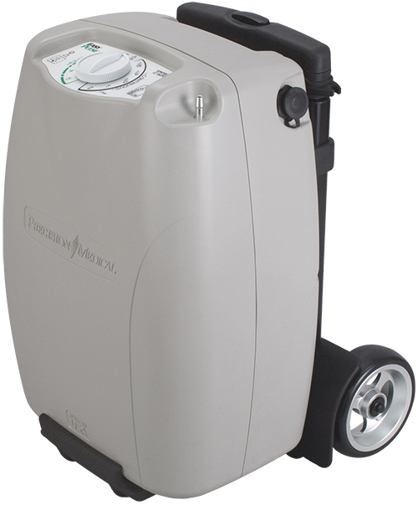
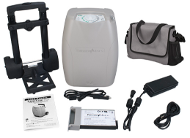
Precision Medical EasyPulse TOC
Product Features and Specs
PM4400
Accessories: AC Power Supply, AS and DC Cords, Battery, Accessory Bag, High-Flow Cannula, Cart and User Manual
Sound Level: 50.6 dBA (on Continuous Setting 2)
42.9 dBA (on Pulse Setting 1)
Cannula: Pulse Mode: Maximum 7’ (2.1m) long – standard adult single lumen Nasal Cannula
Continuous Mode: Maximum 30’ long – standard adult single lumen oxygen Nasal Cannula
Breath Rate Range: Up to 35 breaths per minute
Oxygen Concentration: 87%-95% (on all settings)
Approx. Battery Duration(s) at any breath rate:
Pulse Setting: Continuous Mode:
Setting 1: 3.3 hours 1/8: 5.0 hours
Setting 2: 3.0 hours 1/4: 4.3 hours
Setting 3: 2.8 hours 1/2: 3.3 hours
Setting 4: 2.5 hours 1: 1.8 hours
Setting 5: 2.3 hours 2: 0.8 hours
*Easy to read battery level indicator
* Internal battery charge time: about 4 hours
* Battery must be fully charged before first use
Weight (lbs): 11.5 / 22 (Shipping)
Dimensions: 7.0”L x 10.5”W x 14.63”H
Case Dimensions: 18”L x 21.5”W x 14”H
Power: AC - 100-240VAC (1.0 A @ 120 VAC)
DC - 11-16VDC (5.0 A @ 12VDC)
Warranty: 3 Years on Device, 180 Days Battery
Case GTIN: 00855887006696

Slide 19
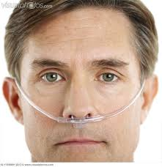
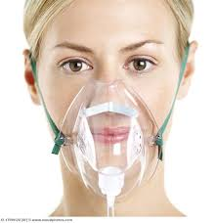
Disposables
Nasal Cannula – device consisting of a tube which on one end splits into two prongs which are placed in the nostrils and used to deliver supplemental oxygen or increased airflow to a patient in need of respiratory help. The other end of the tube is connected to an oxygen supply such as a concentrator or oxygen tank.
Oxygen Mask – a mask placed over the nose and mouth and connected to a supply of oxygen

Slide 20
Disposables
Humidifier Bottle – HUM-ROS6
Swivel Connecter – SWV-ROS
Christmas Tree Adapter – CT-OP
Water Trap – WTR-ROS
Supply Tubing – TUB-ROS7

Slide 21
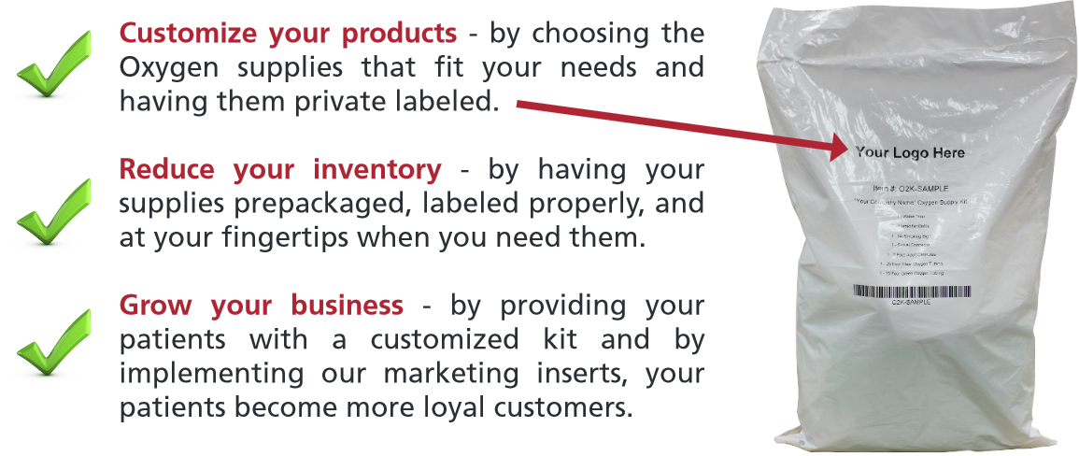
Disposables
Private Label Oxygen Setup Kits

Slide 22
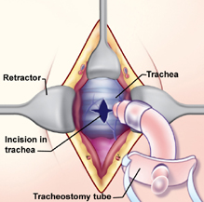
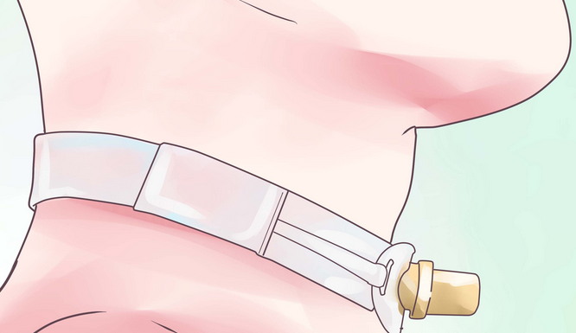
Trach Care and Suction
Tracheostomy – a surgical procedure to create an opening through the neck into the trachea (windpipe). A tube is usually placed through this opening to provide an airway and to remove secretions from the lungs.
Why is the procedure performed?
A large object blocking the airway
An inability to breathe on your own
An inherited abnormality of the larynx or trachea
Breathed in harmful material such as smoke, steam, or other toxic gases that swell and block the airway
Cancer of the neck, which can affect breathing by pressing on the airway
Paralysis of the muscles that affect swallowing
Severe neck or mouth injuries
Surgery around the voicebox (larynx) that prevents normal breathing and swallowing

Slide 23
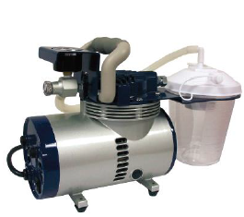
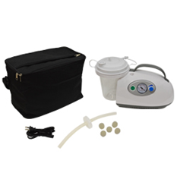
Trach Care and Suction
Aspirator (Suction Machine) – provides assistance for those who have difficulty clearing their throat , swallowing and coughing by clearing the mouth and airway of fluid and mucus. The suction machine enables the person to breathe easier, as well as to eat, drink, and talk more comfortably.
A patient may need suctioning by any of the following methods:
Oral
Nasal
Tracheal
Trach Care and Suction
A suction machine includes a collection bottle with lid and tubing. Suction extension tubing connects the catheter to the machine/jar and is the path for the secretions.
A stiff plastic tube called a catheter or yankauer, is used to suction secretions out of the mouth and throat of a patient who is not strong enough to cough up secretions or when there is a tendency to aspirate (choke on) secretions.
Thin, specially sized catheters are used for suctioning via the nose, trach tubes, or stomas. They are sized according to the medical “French” sizing system.

Slide 24
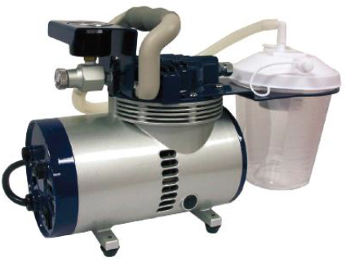
Heavy-Duty Product Offering
Heavy Duty Aspirator
Features and Benefits
Filter design helps prevent contamination
High quality vacuum regulator and anti-vibration vacuum gauge setting
Oil-free, permanent lubrication
Collection bottle with overflow protection
Superior performance and high reliability for continuous operation
Easy carry and cleaning
Warranty: Limited lifetime
HCPCS Code: E0600*

Slide 25
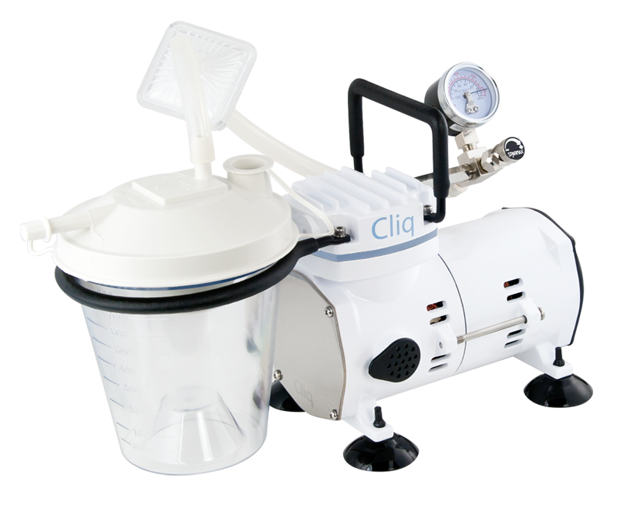
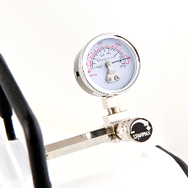
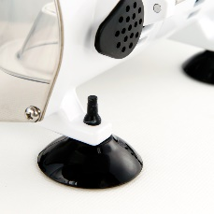
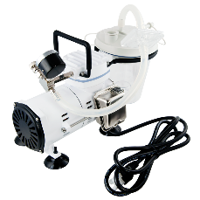
Heavy-Duty Product Offering
The Cliq Aspirator is a single-cylinder aspirator producing high-vacuum, low-flow for medical suction. Portable and durable design. Includes 800 cc collection canister with overflow protection, microbial filter with ¼” hose barb, 2 silicone intermediate tubes and 6’ suction tubing. Suction cups leg mounts provide extra stability while in use.
Features and Benefits
Max Air Flow: -15-17 LPM
Max Vacuum Pressure: -675 mmHg
Pressure Display: Analog Gauge
Weight: 7.7 lbs
Product Dimensions: 13” x 6” x 8.25”
Carton Dimensions: 14” x 7.5” x 9.75”
Electrical Requirements: 110-120V/220-240V (50-60Hz)
Power Cord Length: 6’
Operating Temperature: 32° - 104° F
Operating Relative Humidity: 0-95%
Storage and Transport Temp: -40° - 158° F
Storage and Transport Humidity: 0-95%
Warranty: Two Years
HCPCS Code: E0600
GTIN: 24712946603107
*In stock at Location 20
CF608

