Slide 1
New ProBasics PBFEB3M
3 Motor Full Electric Bed
7-22-20

Slide 2
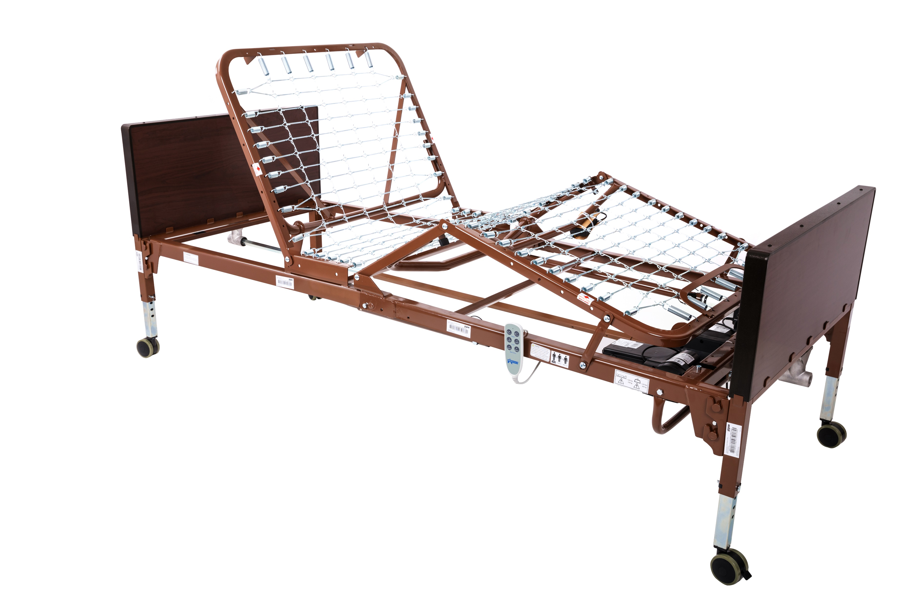
New ProBasics PBFEB3M Bed

Slide 3
Introduction
Introducing the new ProBasics 3 Motor Full Electric bed! This bed replaces the prior ProBasics 3 Motor Full Electric bed that we have sold successfully for over 3 years.
  Our NEW three motor Full Electric Bed/Bed Packages will be available in both a standard height and also in a Low Bed version at a slightly higher price.
  Initially, our beds will be stocked in the Standard Height version only and we will be adding the Low Bed version soon. If your customer absolutely needs Low Beds immediately, we are absolutely willing and able to accommodate them by sending along additional set(s) of Low Bed Ends with their shipment. They just need to enter the item number for the Low Bed/Bed Package version and they will be included in their shipment.
  This training deck will define the specific upgrades and enhancements over the past model.

Slide 4
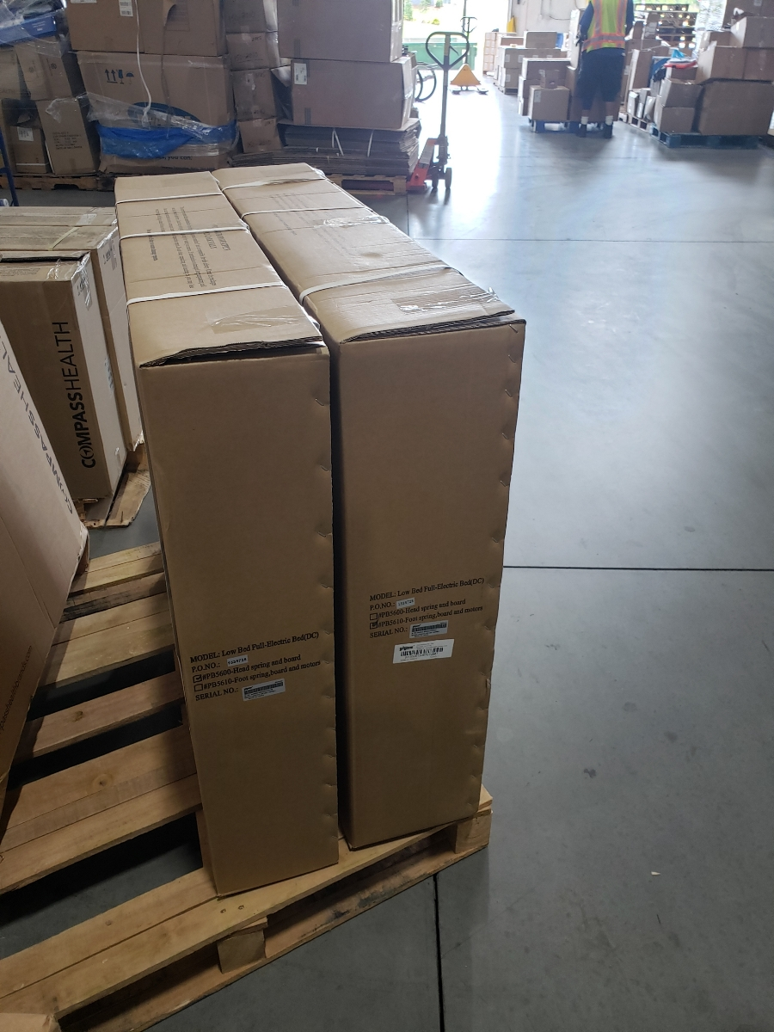
Packaging
The ProBasics PBFEB3M is shipped in two large boxes:
One box contains the head section and standard height headboard.
The second box contains the foot section and standard height footboard.
Packaging has been enhanced for durability and protection of components during shipping.

Slide 5
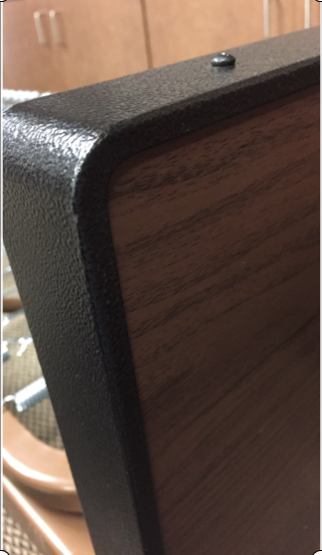
Upgrades – Head and Footboards
Improved head and footboards:
The new ProBasics PBFEB3M bed features durable steel end caps protecting the outer surround of the bed ends.
This end cap has an attractive dark semi-gloss finish that resists scratching and signs of wear.

Slide 6
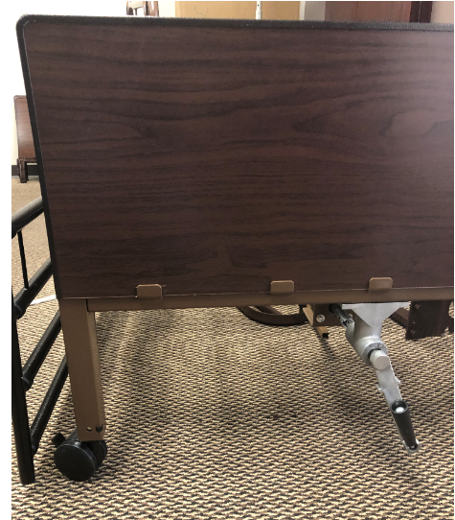
Upgrades – Head and Footboards cont’d
The improved wood grain panels are both attractive and significantly more durable than
our previous model.
The steel gearbox and emergency removable hand crank significantly increase durability and longevity.

Slide 7
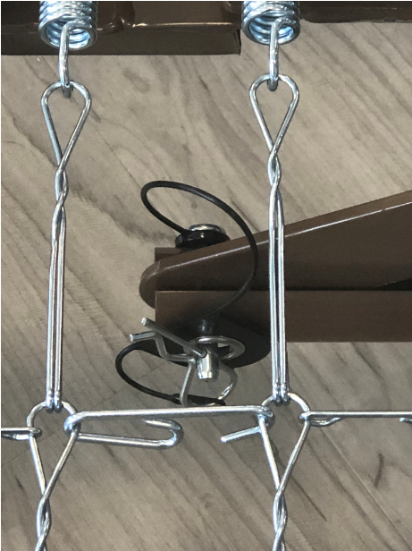
Upgrades – Head Motor Pull Tube Hardware
Improved head motor extension tube hardware:
The new bed features a longer clevis pin that is anchored to the head motor tube to alleviate any loss or misplacement of individual hardware components.
We also feature a larger cotter pin for easy assembly and disassembly.

Slide 8
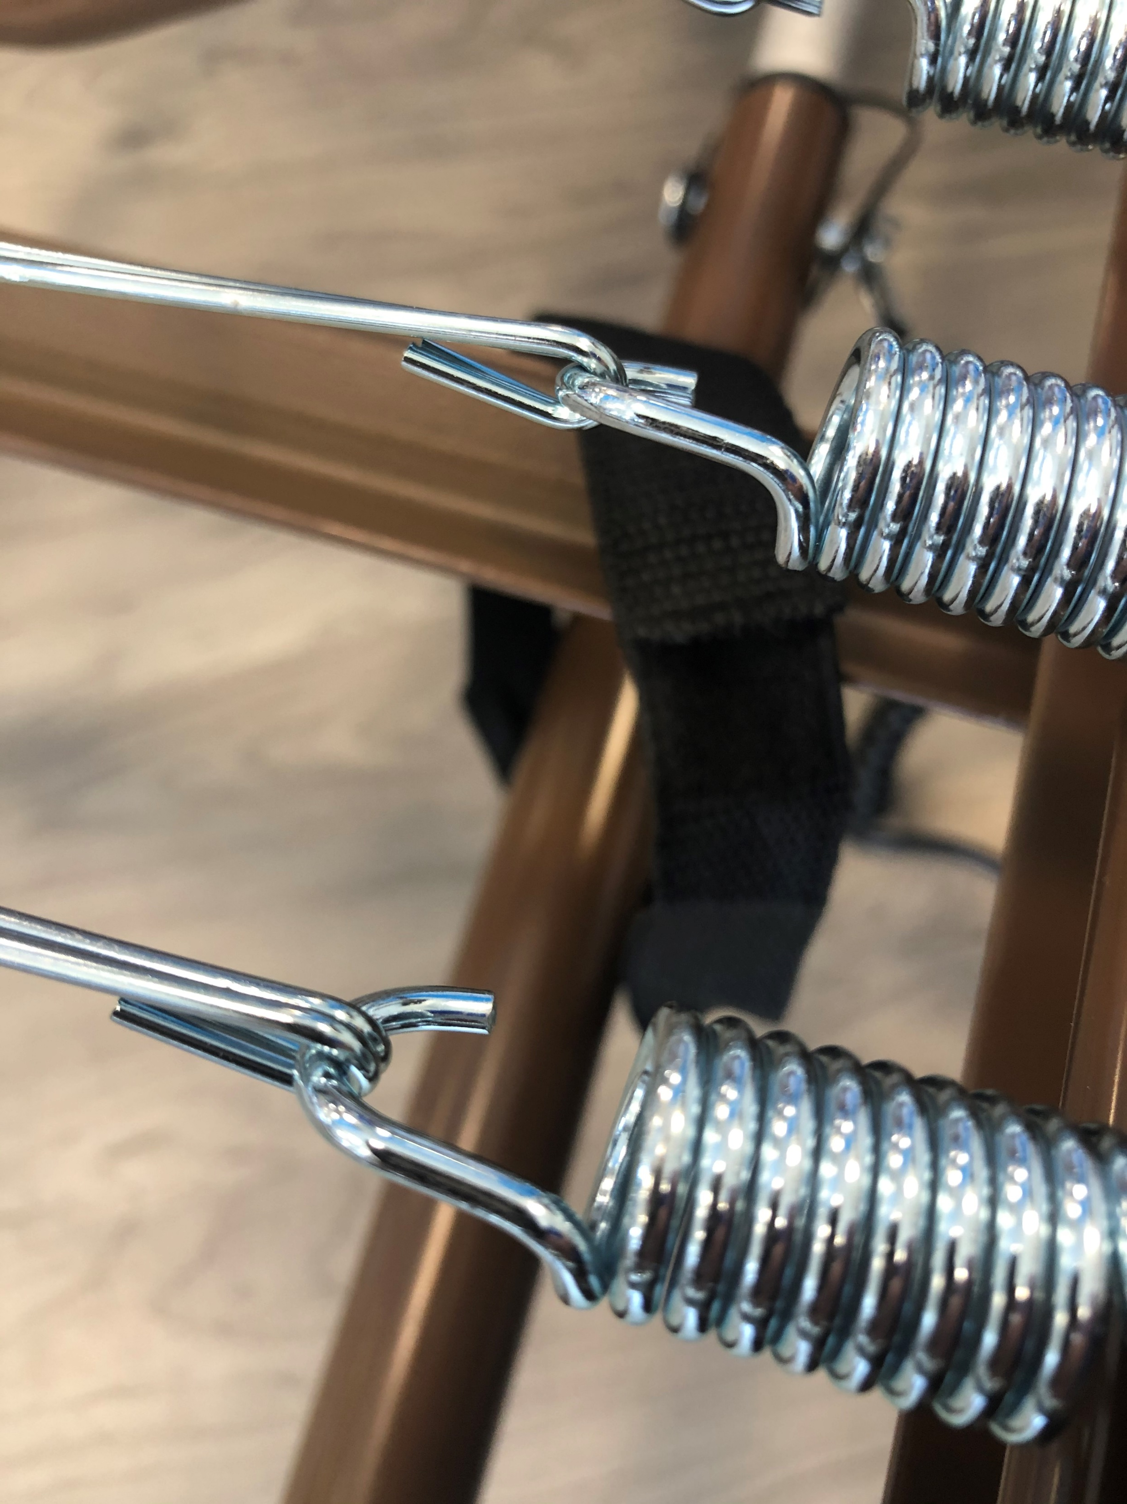
Upgrades – Head Motor Pull Tube Anchor Strap
The new bed features a durable Velcro strap that anchors the head motor tube to the bed frame quickly and effectively for transport.

Slide 9
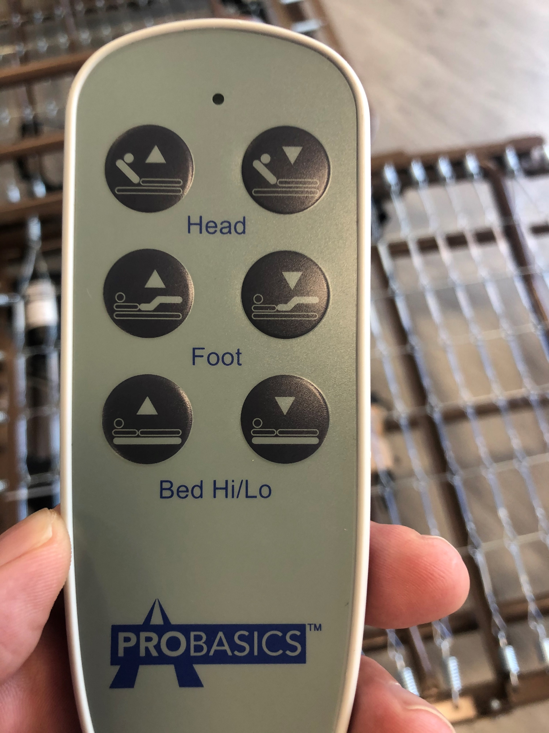
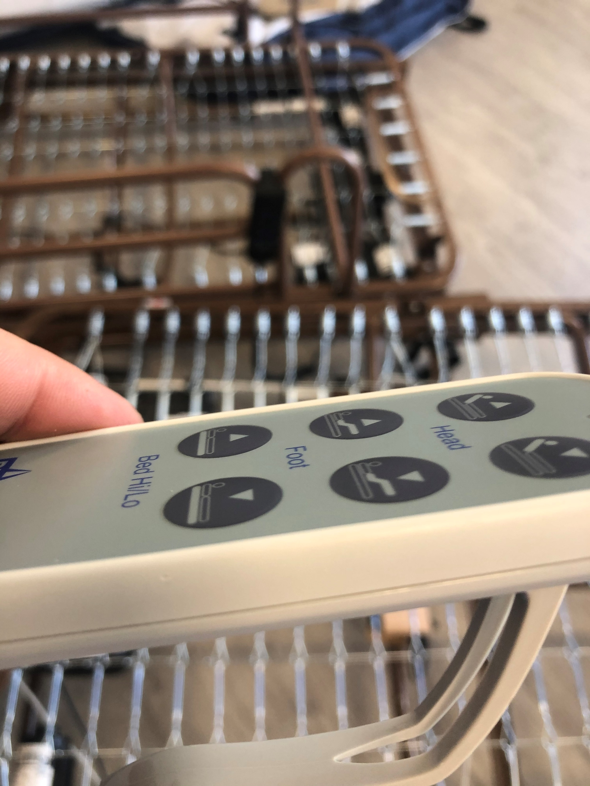
Upgrades – Hand Pendant
The new 3 function hand pendant is an attractive off-white finish and is clearly marked for end user convenience. This pendant also features a large replaceable mounting clip that will attach to the headboard or siderails.

Slide 10
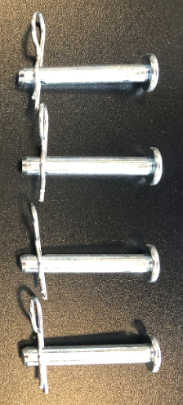
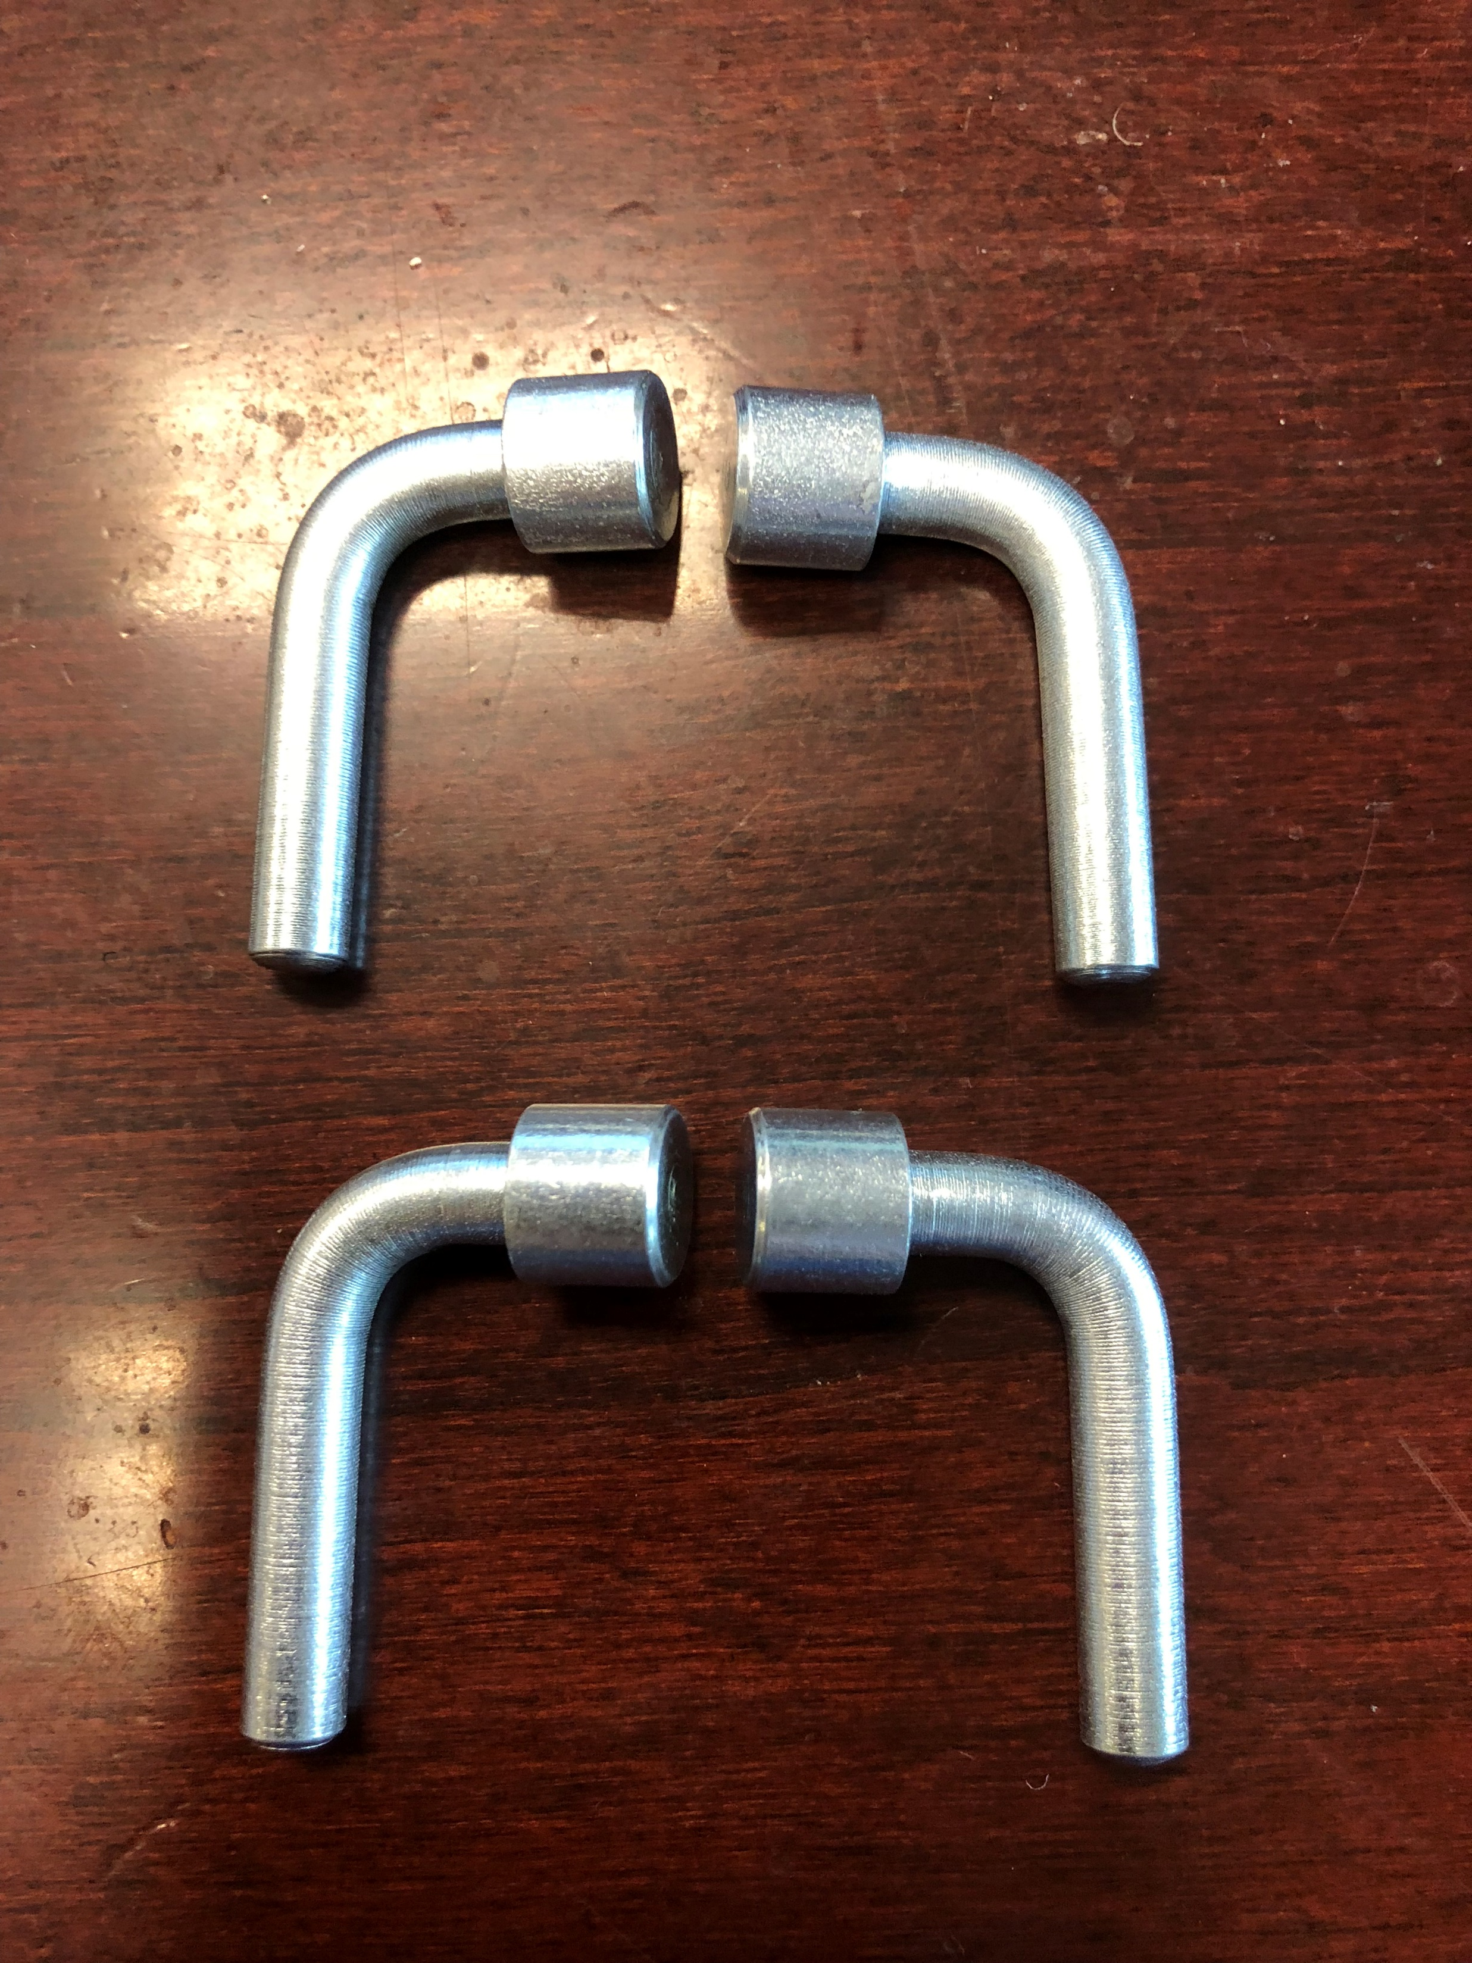
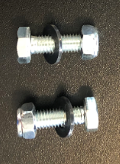
Complete Hardware Kit
The new bed also includes a full hardware kit. The kit contains 4 L-shaped corner lock pins, 4 head and footboard leg lock clevis pins with cotter pins, and 2 nut and bolts to secure and reinforce the head and foot sections once joined.
Head and footboard leg locks
Head and footboard corner locks
Head and foot section center locks

Slide 11
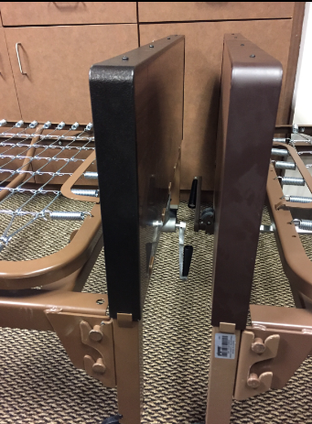
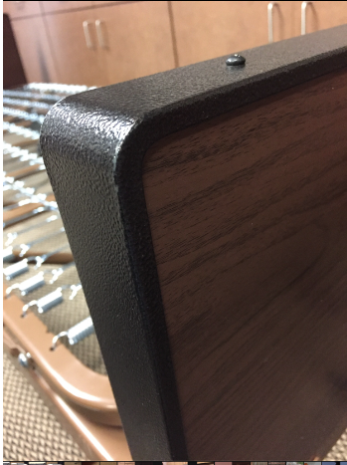
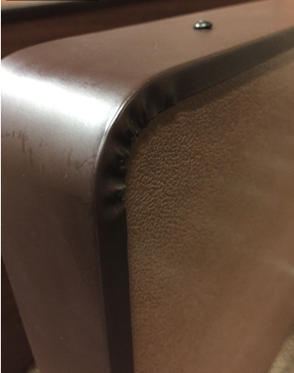
Side by Side Comparison – Bed Ends
New
Old
New
Old

Slide 12
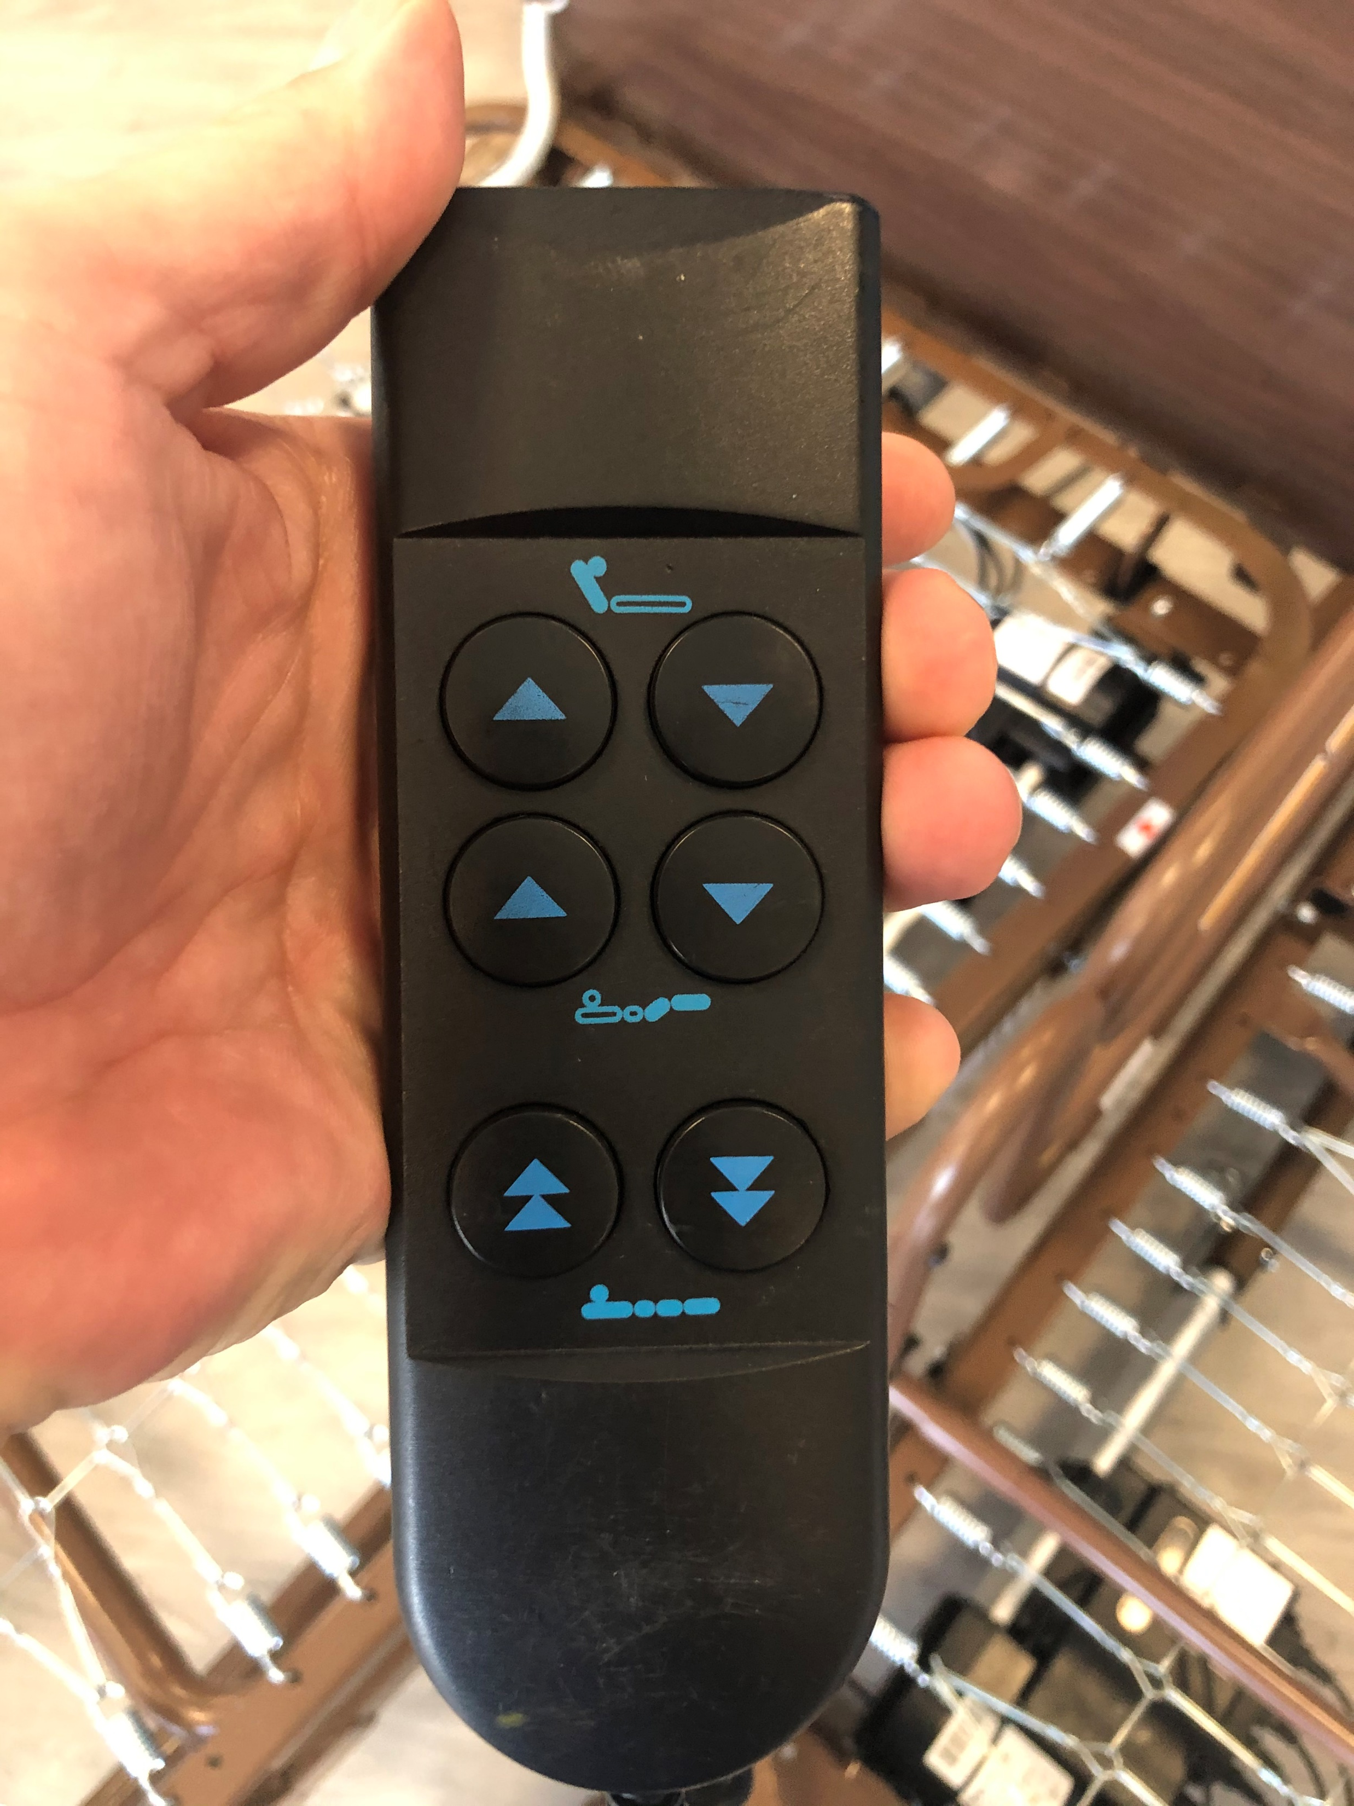
Side by Side Comparison – Hand Pendants
Note – the two different colored hand pendants will help determine which 3 motor bed the customer owns
New
Old

Slide 13
Choosing the right Full-electric Bed
2 OR 3 MOTOR
FULL-ELECTRIC BED?
2 MOTOR
3 MOTOR
STANDARD HEIGHT
PBFEB
LOW
HEIGHT
PBFEBLO
STANDARD HEIGHT
PBFEB3M
LOW
HEIGHT
PBFEB3MLO

Slide 14
3 Motor with Standard Bed ends

Slide 15
3 Motor with Standard & Low Bed ends
New

Slide 16
New 3 Motor Bed Common Parts
ITEM | DESCRIPTION
X1FE3MDG01 | PBFEB3M - HIGH-LOW MOTOR
X1FE3MDG02 | PBFEB3M - FOOT MOTOR
X1FE3MDG03 | PBFEB3M - HEAD MOTOR
X1FE3MDG04 | PBFEB3M - HAND PENDANT
X1FE3MDG05 | PBFEB3M - JUNCTION BOX

Slide 17
New 3 Motor Bed Accessories
ITEM NUMBER | DESCRIPTION
X1PBHBEXT | 4” bed extender for semi and full electric beds (PBHBSMB, PBHBFEB)
HDC-GAPCUSH_6 | 4” foam mattress extender block
PBHBCART36 | Bed cart/Transporter (available September 2020)

Slide 18
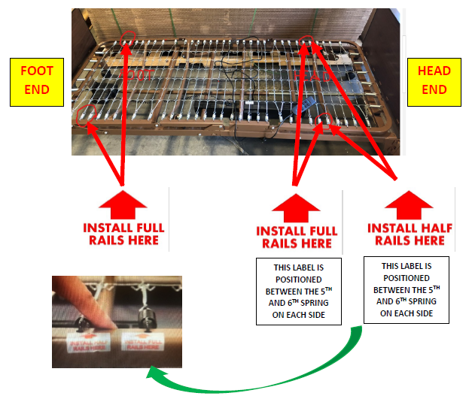
3 Motor with Standard & Low Bed ends

